Slide 1

Breast Cancer Prediction using Machine Learning Algorithms
Data Acquisition,
Wrangling & Exploratory Analysis
CSCI 7090 Data Science and Machine Learning Project
Team 1 Members:
Bright Agbenu
Sarah Sejoro
Anandhi Kandaswamy
Notes:
[Sources] - User-provided notebook: Breast_Cancer_EDA_Notebook.ipynb (analysis content and figures). - User-provided template: template.pptx (layout/branding reference). - UCI Machine Learning Repository, Breast Cancer Wisconsin (Diagnostic): https://archive.ics.uci.edu/dataset/17/breast+cancer+wisconsin+diagnostic (accessed 2026-04-14).

Slide 2
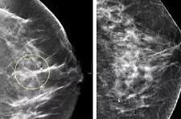
Introduction
Images of Breast Cancer
Breast Cancer accounts for approximately 15.5% of new cancer cases and 6.8% of all cancer‑related deaths in 2025
5‑year relative survival rate of nearly 91.7%. (CDC, 2025)
13% lifetime risk in women and 1% lifetime risk in men (ACS, 2026)
Leading cause of mortality in women worldwide
Early and precise diagnostic interventions are essential
Notes:
[Sources] - UCI Machine Learning Repository, Breast Cancer Wisconsin (Diagnostic): https://archive.ics.uci.edu/dataset/17/breast+cancer+wisconsin+diagnostic (accessed 2026-04-14).
https://radiologybusiness.com/topics/medical-imaging/womens-imaging/breast-imaging/photo-gallery-what-does-breast-cancer-look-mammography - User-provided notebook: Breast_Cancer_EDA_Notebook.ipynb (fetch code and dataset profile).

Slide 3
Literature Search Methodology
Images of Breast Cancer
Peer‑reviewed journal articles and conference papers related to the application of ML and DL in breast cancer diagnosis and disease classification.
keywords including “breast cancer diagnosis,” “machine learning,” “deep learning,” “disease classification,” “digital pathology,” and “medical imaging ML models.” Databases consulted included PubMed, IEEE Xplore, ScienceDirect, and Google Scholar.
Notes:
[Sources] - UCI Machine Learning Repository, Breast Cancer Wisconsin (Diagnostic): https://archive.ics.uci.edu/dataset/17/breast+cancer+wisconsin+diagnostic (accessed 2026-04-14). - User-provided notebook: Breast_Cancer_EDA_Notebook.ipynb (fetch code and dataset profile).
https://radiologybusiness.com/topics/medical-imaging/womens-imaging/breast-imaging/photo-gallery-what-does-breast-cancer-look-mammography

Slide 4
Literature Review
Traditional screening tools such as mammography, breast MRI, ultrasound, and PET scans often demonstrate limited accuracy, sometimes as low as 60–70%
Supervised learning models with with boosted trees and SVM-based approaches often ranked among the best performers for radiomics and clinical-feature classification. (Zhou et al., 2024; Li et al., 2024; Xiao et al., 2022; Yao et al., 2024)
Studies also show that combining radiomics with clinical variables can improve prediction. (Zhou et al., 2024; Li et al., 2024)
Prioritizing high-impact variables like tumor size, age, and metastasis, researchers significantly enhanced model reliability and reduced computational complexity (La Moglia & Almustafa, 2025).
Arravalli et al. (2025) addresses interpretability via explainable AI (XAI) can enhance trust of clinicians in DS/ ML models but high interpretability came at a performance cost due to data complexicity.
Notes:
[Sources] - UCI Machine Learning Repository, Breast Cancer Wisconsin (Diagnostic): https://archive.ics.uci.edu/dataset/17/breast+cancer+wisconsin+diagnostic (accessed 2026-04-14). - User-provided notebook: Breast_Cancer_EDA_Notebook.ipynb (fetch code and dataset profile).

Slide 5
Limitations
Adoption of machine learning systems in actual healthcare processes is one of the primary challenges.
Majority of models are trained/evaluated in controlled benchmarks rather than clinical environment.
Limitations in interpretability and explainability aspects of DS/ ML models.
Lack of clinical validation in real healthcare settings.
Sparse integration of multimodal data (imaging + clinical + genomics).
Generalizability remains a major concern due to dataset shift across institutions, scanners, and patient populations, especially in radiomics studies.
Performance can vary with preprocessing, feature extraction choices, and class imbalance handling.
Notes:
[Sources] - UCI Machine Learning Repository, Breast Cancer Wisconsin (Diagnostic): https://archive.ics.uci.edu/dataset/17/breast+cancer+wisconsin+diagnostic (accessed 2026-04-14). - User-provided notebook: Breast_Cancer_EDA_Notebook.ipynb (fetch code and dataset profile).

Slide 6
Research Gaps
Most studies focus on model performance metrics such as accuracy, F1-score, precision, and recall.
There is limited research in the evaluation of XAI in ensemble models.
This project uses a voting ensemble to compare the explanation agreement analysis of the Random Forest feature importance and the SHAP XAI models.
We also try to understand if different explainability methods agree on what features matter.
We evaluated whether explanations are consistent across methods, and identified stable biomarkers in breast cancer diagnosis.
Notes:
[Sources] - UCI Machine Learning Repository, Breast Cancer Wisconsin (Diagnostic): https://archive.ics.uci.edu/dataset/17/breast+cancer+wisconsin+diagnostic (accessed 2026-04-14). - User-provided notebook: Breast_Cancer_EDA_Notebook.ipynb (fetch code and dataset profile).

Slide 7
Literature Review
La Moglia & Almustafa (2025) found that Logistic Regression and Light Gradient Boosting Machine (LGBM) are highly effective, with testing accuracies exceeding 91%.
CNN and other deep learning methods can be more effective compared to traditional algorithms, such as SVM. (Reddy et al., 2024; Ghantasala et al., 2023)
Ensemble and hybrid models can also be utilized to improve predictive accuracy and diagnostic assistance (Reddy et al., 2024; Ghantasala et al., 2023; Ahmed et al., 2025; Edafetanure-Ibeh et al., 2025; Brunyé et al., 2024).
Notes:
[Sources] - UCI Machine Learning Repository, Breast Cancer Wisconsin (Diagnostic): https://archive.ics.uci.edu/dataset/17/breast+cancer+wisconsin+diagnostic (accessed 2026-04-14). - User-provided notebook: Breast_Cancer_EDA_Notebook.ipynb (fetch code and dataset profile).

Slide 8
Research Questions
What ensemble machine learning methods help improve predictive accuracy of breast cancer diagnosis using the Wisconsin Breast Cancer dataset?
Does an ensemble model improve classification performance compared to individual models?
What combination of ensemble methods with explainable AI (XAI) can improve breast cancer prediction and interpretability?
Which features are consistently identified as important across different XAI methods?
Do different explanation techniques agree on feature importance?
Can ensemble models improve breast cancer classification by combining multiple learners to reduce individual algorithm variance, bias, and noise, result in higher accuracy, and better stability than single models?
Notes:
[Sources] - UCI Machine Learning Repository, Breast Cancer Wisconsin (Diagnostic): https://archive.ics.uci.edu/dataset/17/breast+cancer+wisconsin+diagnostic (accessed 2026-04-14). - User-provided notebook: Breast_Cancer_EDA_Notebook.ipynb (fetch code and dataset profile).

Slide 9
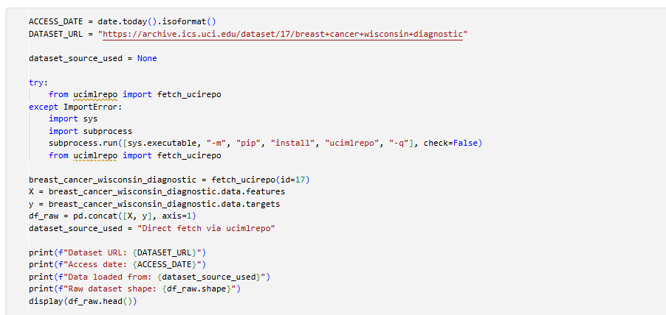
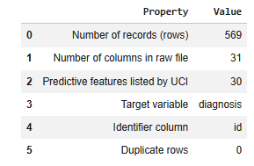

Data Acquisition and Inspection
Data Source
Data retrieval code snippet
Source: UCI Machine Learning Repository, Breast Cancer Wisconsin (Diagnostic).
The 30 real-valued predictors come from digitized fine needle aspirate images and describe cell nucleus characteristics.
The target is a clinically meaningful binary diagnosis label: benign (B) or malignant (M).
The dataset contained no missing data except one empty column
Raw dataset structure
Data Reference
Notes:
[Sources] - UCI Machine Learning Repository, Breast Cancer Wisconsin (Diagnostic): https://archive.ics.uci.edu/dataset/17/breast+cancer+wisconsin+diagnostic (accessed 2026-04-14). - User-provided notebook: Breast_Cancer_EDA_Notebook.ipynb (fetch code and dataset profile).

Slide 10
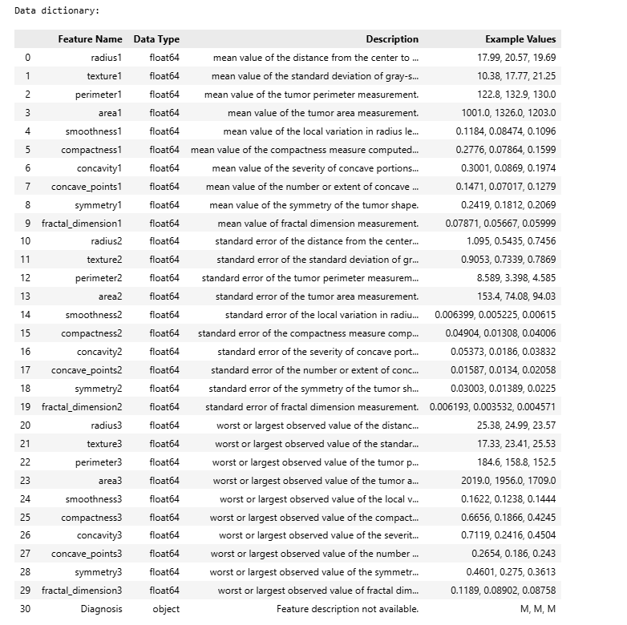
Feature Map and Data Dictionary
Data Dictionary
Summary
The dataset contains 31 variables, including 30 numeric predictor features and 1 categorical target variable, Diagnosis.
The predictor variables are biomedical tumor measurements stored as float64, while Diagnosis is stored as an object variable with labels such as M and B.
The features are organized into three groups: mean measurements, standard error measurements, and worst-case measurements.
These measurements cover important tumor characteristics such as radius, texture, perimeter, area, smoothness, compactness, concavity, concave points, symmetry, and fractal dimension.
Notes:
[Sources] - User-provided notebook: Breast_Cancer_EDA_Notebook.ipynb (condensed data dictionary, descriptive statistics, and interpretation). - UCI Machine Learning Repository dataset page for variable definitions: https://archive.ics.uci.edu/dataset/17/breast+cancer+wisconsin+diagnostic (accessed 2026-04-14).

Slide 11
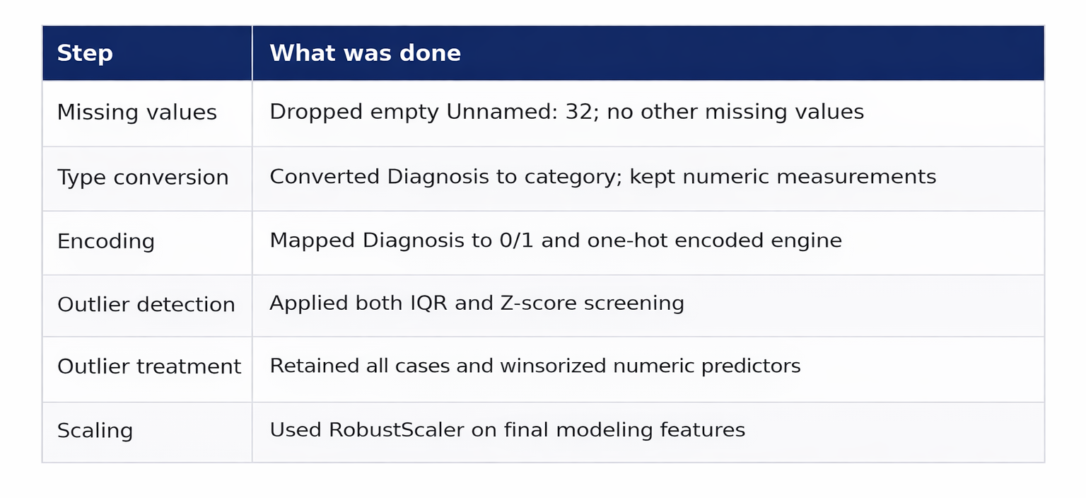
Data Wrangling and Preprocessing
Preprocessing steps
No imputation was needed beyond removing the fully empty column.
Diagnosis was converted to a categorical label for EDA and to a numeric target for later modeling.
The cleaned table retained all 569 patient records with no duplicate rows
Notes:
[Sources] - User-provided notebook: Breast_Cancer_EDA_Notebook.ipynb (cleaning pipeline, missing-value analysis, and encoding decisions).

Slide 12
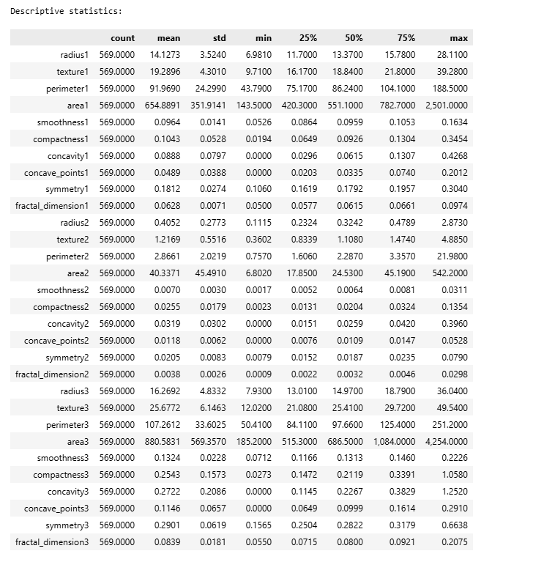
Descriptive Summaries
Descriptive summary
Some variables show substantial variation in scale. For example, features such as area1 and area3 have much larger mean values and standard deviations than variables like fractal_dimension1 and fractal_dimension3, which indicates that the dataset contains measurements recorded on very different numeric ranges.
A comparison of the mean and median suggests that several features are slightly right-skewed. This is especially noticeable in variables such as area1, area2, area3, concavity3, and compactness3, where the mean is higher than the median, suggesting the presence of larger values pulling the average upward. The wide gaps between minimum and maximum values also point to possible outliers in features like radius3, perimeter3, and area3.
The quartiles further show that some variables are more tightly clustered, while others are more spread out. For instance, smoothness1 and fractal_dimension1 appear relatively stable, whereas size-related features such as radius, perimeter, and area show much broader dispersion.
Notes:
[Sources] - User-provided notebook: Breast_Cancer_EDA_Notebook.ipynb (condensed data dictionary, descriptive statistics, and interpretation). - UCI Machine Learning Repository dataset page for variable definitions: https://archive.ics.uci.edu/dataset/17/breast+cancer+wisconsin+diagnostic (accessed 2026-04-14).

Slide 13
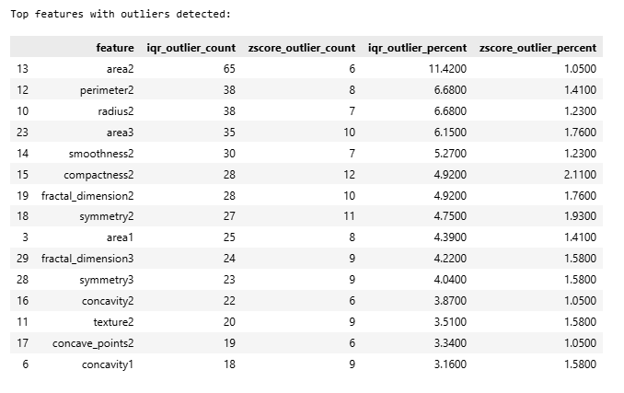
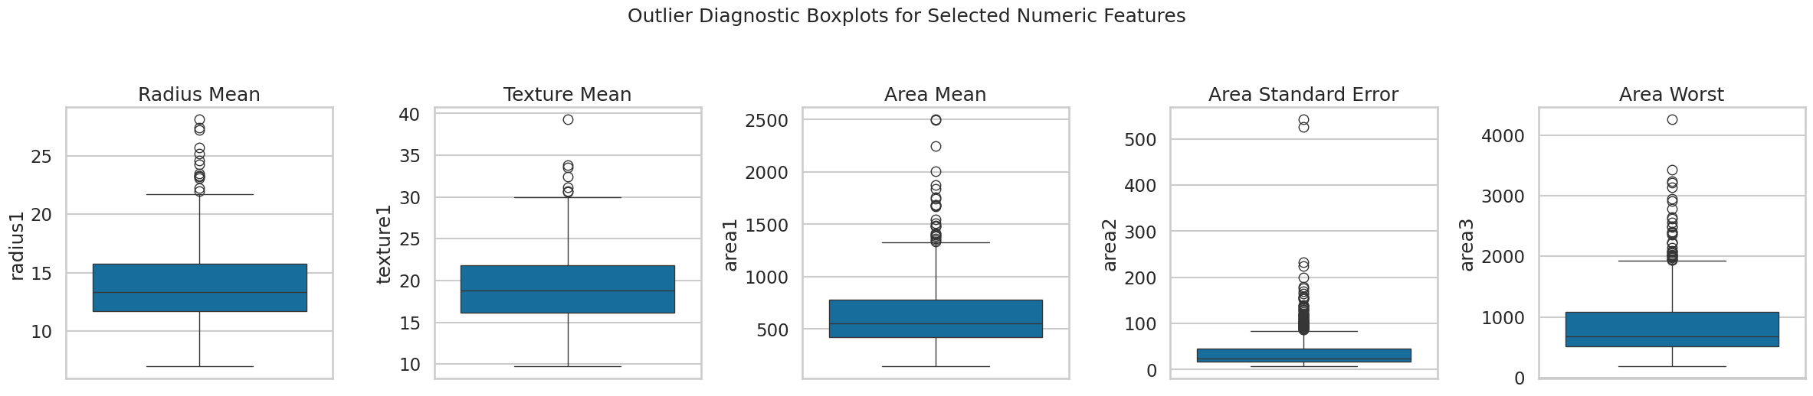
Outlier Detection (IQR and Z-Score Method)
Interpretation
The affected variables are mostly size and boundary-shape measures, which are plausible markers of malignancy rather than obvious data entry errors.
Area2 stands out the most, with the highest IQR outlier count at 65 cases, followed by perimeter2 and radius2 with 38 cases each, which suggests that several size-related features contain unusually extreme values.
In general, the IQR method identifies more outliers than the Z-score method across most features, indicating that the dataset may contain skewed distributions or moderately extreme observations that the stricter Z-score method captures less often.
Notes:
[Sources] - User-provided notebook: Breast_Cancer_EDA_Notebook.ipynb (boxplot figure, outlier summary table, IQR and Z-score methodology, and interpretation).

Slide 14
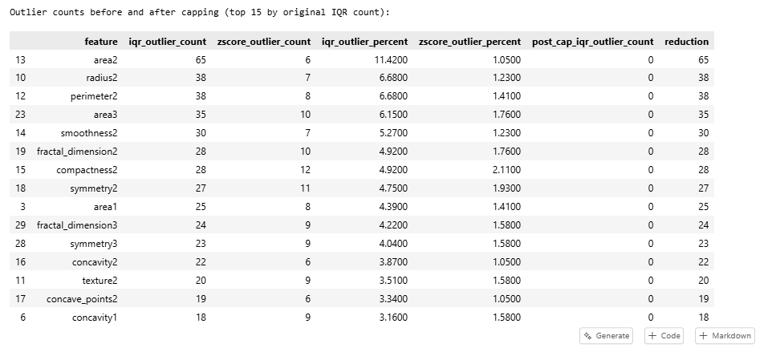
Outlier Treatment
Outlier analysis after treatment
Rationale
To avoid discarding clinically informative records, the notebook capped predictor values to IQR limits instead of deleting rows; the worst-affected features fell to zero post-cap IQR outliers.
Because the dataset is relatively small, extreme values may represent real malignant cases rather than errors.
All observations were retained to avoid losing potentially important clinical information.
Instead of removing rows, numeric predictors were winsorized using IQR-based caps.
This approach reduced the influence of extreme values while preserving all patient records.
Notes:
[Sources] - User-provided notebook: Breast_Cancer_EDA_Notebook.ipynb (boxplot figure, outlier summary table, IQR and Z-score methodology, and interpretation).

Slide 15
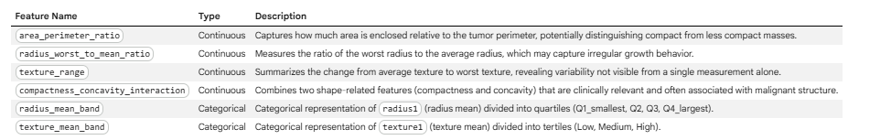
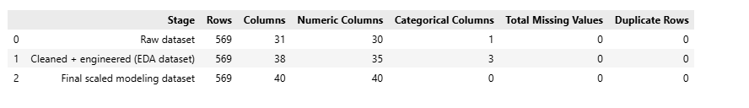
Feature Engineering and Scaling
Engineered features
Final scaled dataset preview
Rationale for using RobustScaler
RobustScaler was selected because it scales features using the median and interquartile range rather than the mean and standard deviation.
This makes it a strong choice for a biomedical dataset like this one, where some variables remain skewed even after outlier capping.
It is more stable than MinMaxScaler or StandardScaler when extreme values are present.
Notes:
[Sources] - User-provided notebook: Breast_Cancer_EDA_Notebook.ipynb (feature engineering, encoding, and RobustScaler implementation).

Slide 16
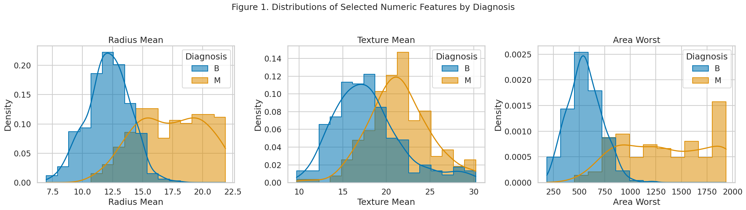
Distributional Differences by Diagnosis
The figure below compares key numeric features across benign and malignant cases
The distributions show the clearest class shifts in radius mean and area worst, where malignant tumors occupy larger values.
Texture mean still contributes signal, but its overlap suggests it is more informative in combination with other variables than by itself.
Notes:
[Sources] - User-provided notebook: Breast_Cancer_EDA_Notebook.ipynb (Figure 1 and accompanying interpretation).

Slide 17
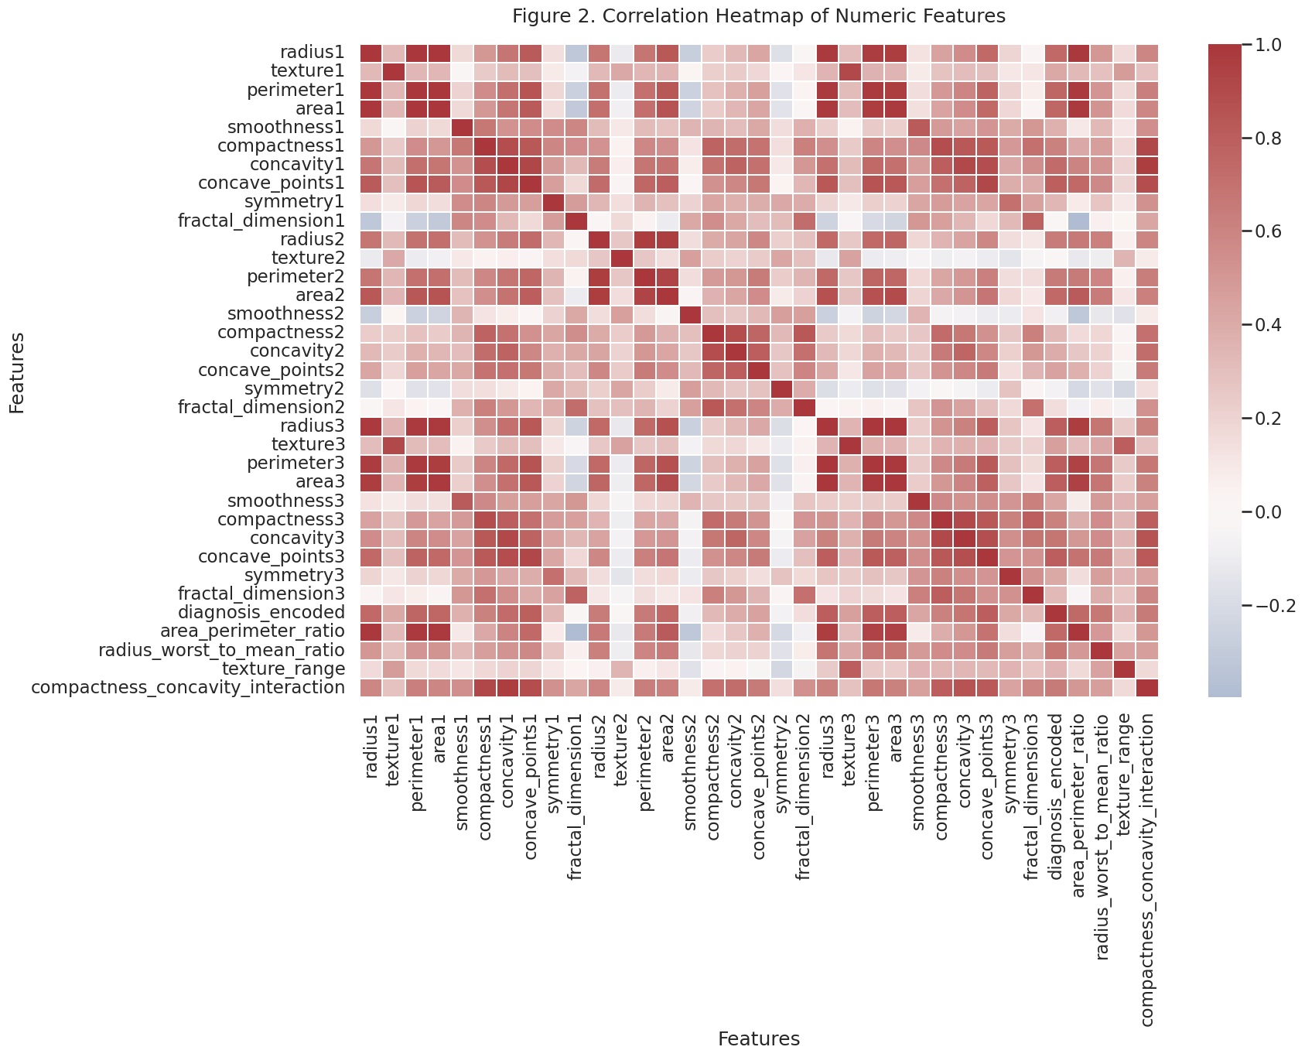
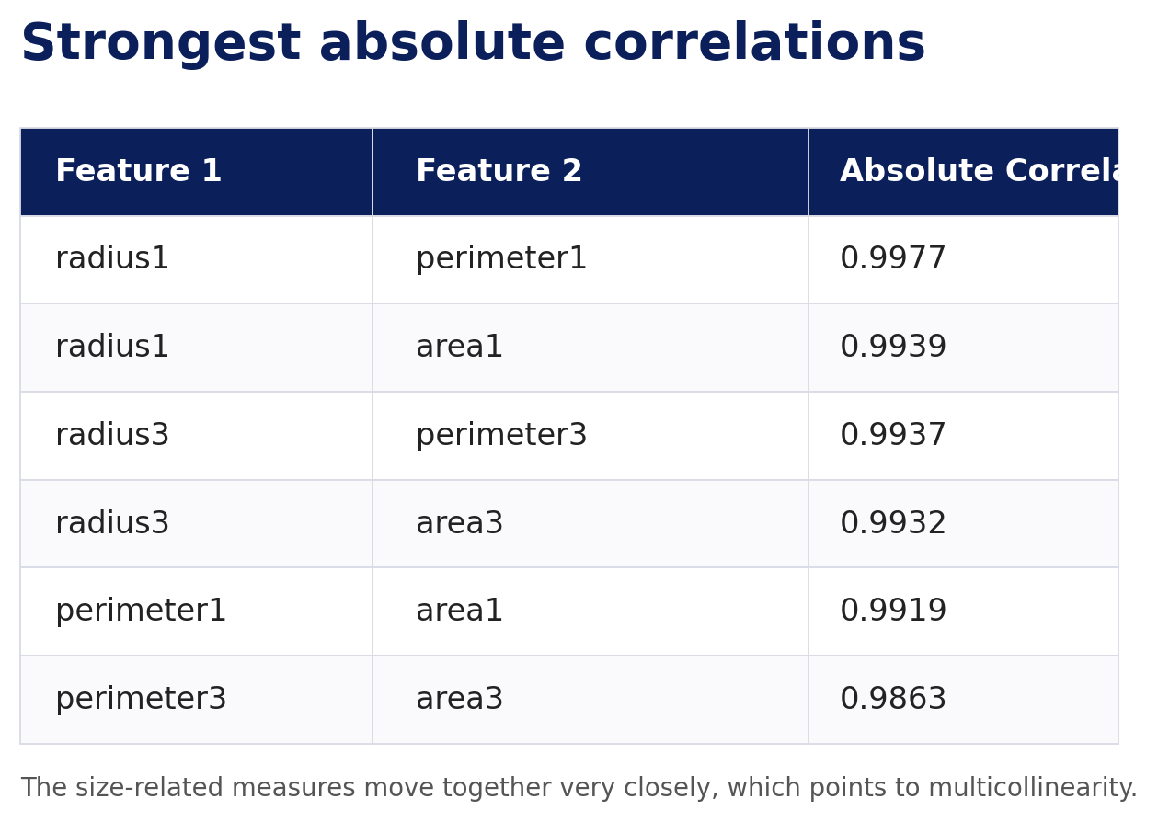
Correlation Structure
Figure 2 confirms that the dataset contains strong redundancy among size-related measurements
Radius, perimeter, and area move together almost perfectly.
The single strongest raw correlation is radius1 vs perimeter1 at 0.9977.
This matters for later modeling because linear methods can become unstable when highly collinear predictors are left untreated.
Notes:
[Sources] - User-provided notebook: Breast_Cancer_EDA_Notebook.ipynb (Figure 2 heatmap, strongest-correlation table, and interpretation).

Slide 18
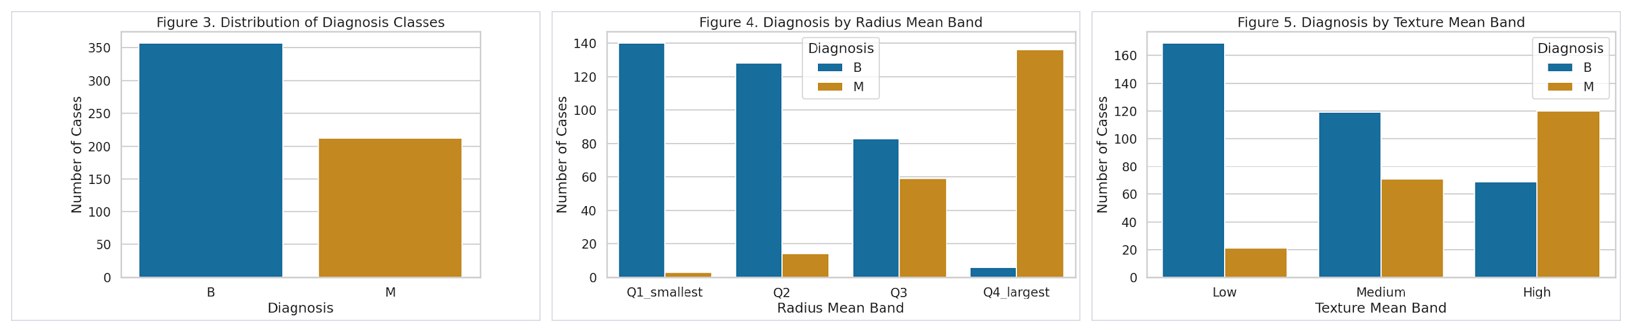
Class Balance and Banded Feature Analyses
Figures 3–5 show both the overall class mix and how diagnosis shifts across engineered bands
The dataset is moderately imbalanced: 62.74% benign versus 37.26% malignant.
Radius bands show a very strong monotonic shift, with the largest quartile dominated by malignant cases.
Texture bands also move toward malignancy at higher values, but the separation is weaker than the size-based signal.
Notes:
[Sources] - User-provided notebook: Breast_Cancer_EDA_Notebook.ipynb (Figures 3–5, class distribution counts, radius-band crosstab, texture-band crosstab, and interpretation).

Slide 19
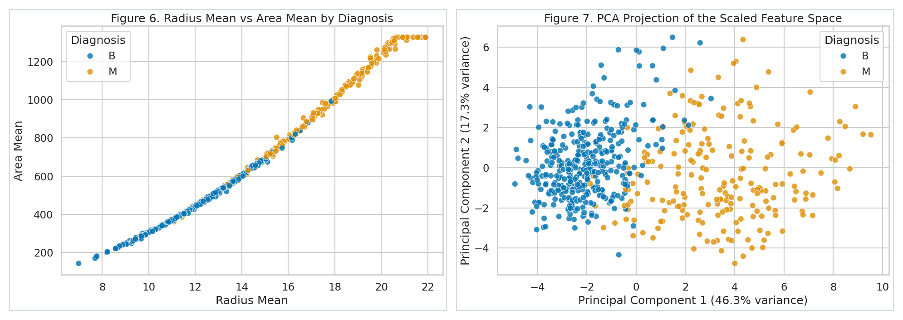
PCA Separation in Original and Reduced Feature Space
Figures 6–7 show that class structure remains visible both before and after dimensionality reduction
In the raw feature view, malignant cases cluster where both radius mean and area mean are large.
In the PCA view, the first two principal components explain 63.64% of total variance and still preserve substantial class separation.
The residual overlap suggests there is room for flexible classifiers to improve on purely linear boundaries.
Notes:
[Sources] - User-provided notebook: Breast_Cancer_EDA_Notebook.ipynb (Figures 6–7 and the reported 63.64% explained variance for PC1+PC2).

Slide 20
Conclusions and Next Steps
Main takeaways
Next steps
The dataset is clean, well-documented, and free of missing values after the empty column is removed.
Tumor size and shape variables dominate the separation between benign and malignant diagnoses.
Outlier capping, engineered ratios/interactions, and Robust scaling produce a defensible model-ready feature matrix.
Perform Train-Test split
Train and compare multiple classification models
Evaluate model performance using accuracy, precision, recall, F1-score, ROC curve, and AUC.
Apply feature selection techniques to identify the most important predictors of breast cancer diagnosis.
Use cross-validation to test the stability and generalizability of the models.
Explore hyperparameter tuning to improve model performance.
Interpret the final model results to highlight the most clinically meaningful features
Notes:
[Sources] - User-provided notebook: Breast_Cancer_EDA_Notebook.ipynb (conclusion and pipeline results). - The recommendation to fit preprocessing on the training split only reflects standard leakage prevention practice for supervised machine learning.

Slide 21
References
Makki, J. (2015). Diversity of breast carcinoma: Histological subtypes and clinical relevance. Clinical Medicine Insights: Pathology, 8, 23–31. https://doi.org/10.4137/CPath.S31563
Wolberg, W., Mangasarian, O., Street, N., & Street, W. (1993). Breast Cancer Wisconsin (Diagnostic) [Dataset]. UCI Machine Learning Repository. https://doi.org/10.24432/C5DW2B.
National Cancer Institute (2025). Retrieved from https://seer.cancer.gov/statfacts/html/breast.html. Assessed on Feb 20, 2026.
American Cancer Society (2026). Retrieved from https://www.cancer.org/cancer/types/breast-cancer/about/how-common-is-breast-cancer.html. Assessed on Feb 20, 2026.
Shang, C., & Xu, D. (2022). Epidemiology of breast cancer. Oncologie, 24(4), 649–663. https://doi.org/10.32604/oncologie.2022.027640
Jaglan, P., Dass, R., & Duhan, M. (2019). Breast cancer detection techniques: Issues and challenges. Journal of the Institution of Engineers (India): Series B, 100(4), 379–386. https://doi.org/10.1007/s40031-019-00391-2
La Moglia, A., & Almustafa, K. M. M. (2025). Breast cancer prediction using machine learning classification algorithms. Intelligence-Based Medicine, 11, 100193. https://doi.org/10.1016/j.ibmed.2024.100193
Yue W, Wang Z, Chen H, Payne A, Liu X. 2018. Machine learning with applications in breast cancer diagnosis and prognosis. Designs. 2(2):13. doi: 10.3390/designs2020013.
Ahsan, M. M., Luna, S. A., & Siddique, Z. (2022). Machine-learning-based disease diagnosis: A comprehensive review. Healthcare (Basel), 10(3), 541. https://doi.org/10.3390/healthcare10030541
Manzoor, M. (2024). Machine learning for early disease diagnosis: A review of techniques in healthcare applications. Premier Journal of Science, 2(4). https://doi.org/10.5281/zenodo.14095684
Moreno-Ibarra, A., et al. (2021). Classification of diseases using machine learning algorithms: A comparative study. Mathematics, 9(15), 1817. https://doi.org/10.3390/math9151817
Scherr, T. F., Douglas, C. E., Schaecher, K. E., Schoepp, R. J., Ricks, K. M., & Shoemaker, C. J. (2024). Application of a machine learning-based classification approach for developing host protein diagnostic models for infectious disease. Diagnostics (Basel), 14(12), 1290. https://doi.org/10.3390/diagnostics14121290
Notes:
[Sources] - UCI Machine Learning Repository, Breast Cancer Wisconsin (Diagnostic): https://archive.ics.uci.edu/dataset/17/breast+cancer+wisconsin+diagnostic (accessed 2026-04-14). - User-provided notebook: Breast_Cancer_EDA_Notebook.ipynb (fetch code and dataset profile).

Slide 22
References
Jafari, A. (2024). Machine-learning methods in detecting breast cancer and related therapeutic issues: A review. Computer Methods in Biomechanics and Biomedical Engineering: Imaging & Visualization, 12(1), Article 2299093. https://doi.org/10.1080/21681163.2023.2299093
La Moglia, A., & Almustafa, K. M. (2025). Breast cancer prediction using machine learning classification algorithms. Intelligence-Based Medicine, 11, Article 100193. https://doi.org/10.1016/j.ibmed.2024.100193
Yedjou, C. G., Tchounwou, S. S., Aló, R. A., Elhag, R., Mochona, B., & Latinwo, L. (2021). Application of machine learning algorithms in breast cancer diagnosis and classification. International Journal of Science and Academic Research, 2(1), 3081–3086.
Brunyé, T. T., Booth, K., Hendel, D., Kerr, K. F., Shucard, H., Weaver, D. L., & Elmore, J. G. (2024). Machine learning classification of diagnostic accuracy in pathologists interpreting breast biopsies. Journal of the American Medical Informatics Association : JAMIA, 31(3), 552–562. https://doi.org/10.1093/jamia/ocad232
Al-Azzam, N., & Shatnawi, I. (2021). Comparing supervised and semi-supervised machine learning models on diagnosing breast cancer. Annals of Medicine and Surgery, 62, 53–64. https://doi.org/10.1016/j.amsu.2020.12.043
Li, X., Li, C., Wang, H., Jiang, L., & Chen, M. (2024). Comparison of radiomics-based machine-learning classifiers for the pretreatment prediction of pathologic complete response to neoadjuvant therapy in breast cancer. PeerJ, 12, e17683. https://doi.org/10.7717/peerj.17683
Xiao, J., Mo, M., Wang, Z., Zhou, C., Shen, J., Yuan, J., He, Y., & Zheng, Y. (2022). The application and comparison of machine learning models for the prediction of breast cancer prognosis: Retrospective cohort study. JMIR Medical Informatics, 10(2), e33440. https://doi.org/10.2196/33440
Yao, J., Zhou, W., Xu, S., Jia, X., Zhou, J., Chen, X., & Zhan, W. (2024). Machine learning-based breast tumor ultrasound radiomics for pre-operative prediction of axillary sentinel lymph node metastasis burden in early-stage invasive breast cancer. Ultrasound in Medicine & Biology, 50(2), 229–236. https://doi.org/10.1016/j.ultrasmedbio.2023.10.004
Zhou, S., Hu, C., Wei, S., & Yan, X. (2024). Breast cancer prediction based on multiple machine learning algorithms. Technology in Cancer Research & Treatment, 23, 15330338241234791. https://doi.org/10.1177/15330338241234791
Notes:
[Sources] - UCI Machine Learning Repository, Breast Cancer Wisconsin (Diagnostic): https://archive.ics.uci.edu/dataset/17/breast+cancer+wisconsin+diagnostic (accessed 2026-04-14). - User-provided notebook: Breast_Cancer_EDA_Notebook.ipynb (fetch code and dataset profile).

